Slide 1
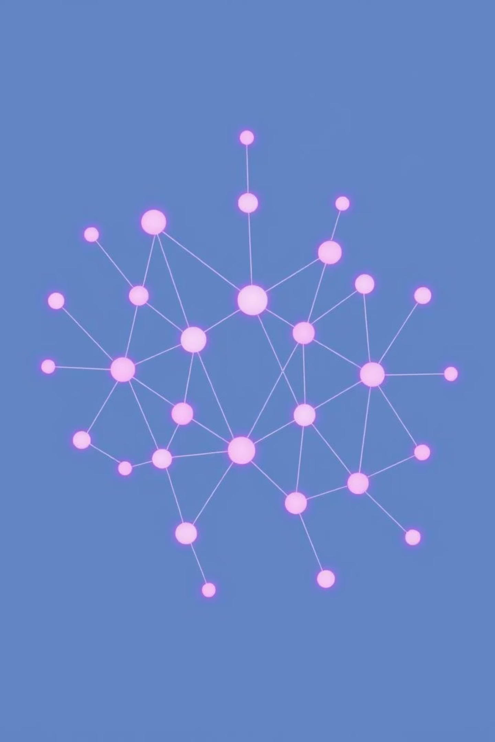
Speech Emotion Recognition using CNN–BiLSTM (RAVDESS Dataset)
Rola Khaled 221017871
Zeina Ahmed 221017888
Malak Maher 221027544
Course: Deep Learning
Objective: Design and deploy a deep learning system to recognise human emotions from speech signals.

Slide 2

Problem Domain & Motivation
What is Speech Emotion Recognition (SER)?
Why does it matter?
SER is the process of identifying human emotional states from spoken language. It deciphers the subtle vocal cues that convey feelings.
Enhanced Human-Computer Interaction (HCI)
Improved customer service in call centres
Mental health support tools
More intuitive AI assistants
Key Challenges
Human Speech → Emotion
Emotion is subtle and temporal
Speech varies in length and loudness
High risk of model bias and class collapse

Slide 3


Dataset & Challenges
The RAVDESS Dataset
Challenges Faced
The Ryerson Audio-Visual Database of Emotional Speech and Song (RAVDESS) was selected for its high quality and clear emotional labelling.
Variable Audio Length: Speech segments naturally differ, requiring standardisation.
Temporal Emotional Cues: Emotions aren't static; their manifestation changes over time within speech.
8 Emotions: Neutral, calm, happy, sad, angry, fearful, disgust, surprise.
Small Dataset: The limited size increases the risk of model overfitting, necessitating careful mitigation strategies.
Clean Data: Studio-recorded, pre-processed speech ensuring minimal noise interference.
Criticality of Preprocessing: Careful preprocessing is paramount to address these challenges and ensure robust model training.

Slide 4



Data Preprocessing Pipeline
A meticulous preprocessing pipeline was established to transform raw audio into a suitable format for deep learning, ensuring data quality and consistency.
Load Audio
Importing raw .wav files into the system.
Trim Silence
Removing non-essential silent segments to focus on speech content.
Pad/Trim to Fixed Duration
Standardising audio lengths for consistent input dimensions.
Extract Log-Mel Spectrograms
Converting audio to a visual representation of frequency and time, crucial for CNN analysis.
Dataset-Level Normalisation
Scaling features to a common range, improving model stability and performance.
Save Clean Training Data
Storing processed data ready for model ingestion.
"Correct preprocessing was the key factor in improving accuracy."

Slide 5





Model Architecture: CNN + BiLSTM
Our hybrid model architecture combines the strengths of Convolutional Neural Networks (CNNs) for spatial feature extraction and Bidirectional Long Short-Term Memory (BiLSTMs) for temporal dependency modelling.
Input
Log-Mel Spectrograms
CNN Layers
Learn spectral emotion patterns from frequency bands.
BiLSTM Layers
Model emotional dynamics and dependencies across time.
Dense Layers
Final classification into emotion categories.
Softmax Output
Probability distribution over emotions.

Slide 6
Training Strategy
Data Split
1
Stratified 80/10/10 split for Training, Validation, and Testing to ensure balanced emotion distribution.
Data Augmentation
2
Application of SpecAugment and environmental noise injection (training data only) to increase dataset diversity.
Adam Optimizer
3
Utilised for efficient gradient descent and convergence.
Learning Rate Scheduling
4
Dynamically adjusted learning rate to enhance training stability and performance.
Early Stopping
5
Preventing overfitting by monitoring validation loss and terminating training when improvement ceases.
"Augmentation improves generalisation, not memorisation."

Slide 7
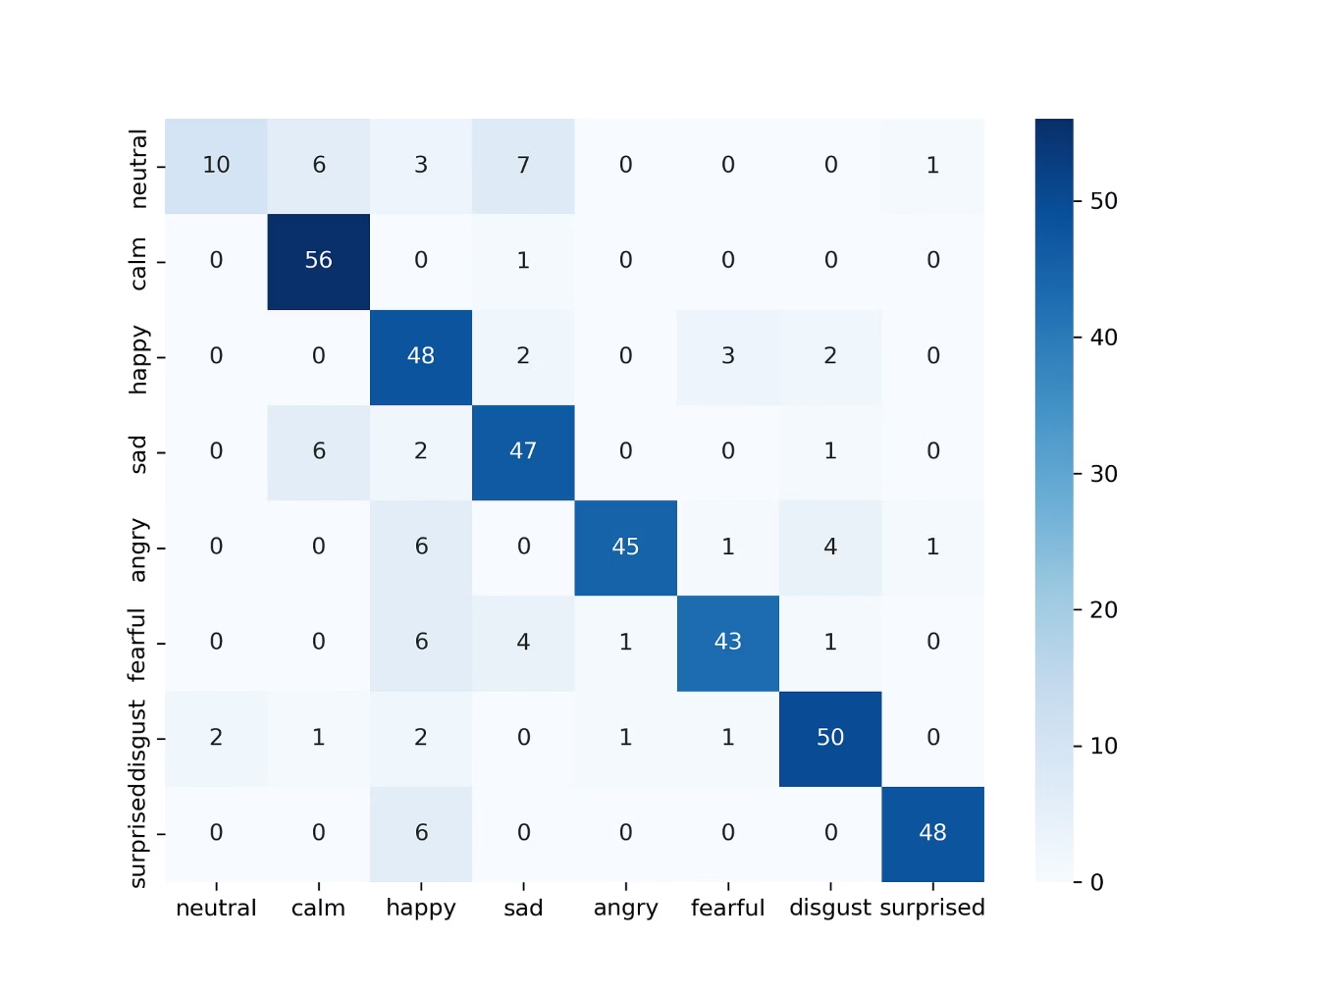
Results & Evaluation
Overall Performance
Confusion Matrix
The model achieved a final test accuracy of approximately 83% on the RAVDESS dataset.
A snapshot of the confusion matrix reveals strong diagonal values, confirming effective classification.
Key Findings:
Balanced Performance: Consistent accuracy across various emotion classes, avoiding bias.
No Class Collapse: Each emotion was correctly distinguished, indicating robust feature learning.
State-of-the-Art Alignment: Results are competitive with established benchmarks for SER on RAVDESS.
Classification Report Highlights
Precision, recall, and F1-scores demonstrate high performance across emotion categories.

Slide 8

Conclusion
1
2
Prediction Pipeline
Deployment Readiness
The seamless flow from WAV input through preprocessing, model inference, to JSON output facilitates real-world application.
Designed for integration into Command-Line Interface (CLI),Application Programming Interface (API) environments.
Data Correctness > Model Complexity
Understanding Failures Leads to Success
Emphasising that high-quality, well-preprocessed data is more impactful than overly complex models.
Analysis of misclassifications provided crucial insights for iterative improvement and robustness.
"This project demonstrates both technical depth and systematic ML problem-solving."

Slide 9


Future Work & Enhancements
To further advance this project, several avenues for improvement and expansion have been identified.
Multi-modal Fusion: Integrating facial expressions and body language for richer emotional context.
Privacy-Preserving SER: Investigating methods for emotion recognition that protect speaker privacy.
Real-time Processing: Optimising the model for lower latency to enable live emotion detection.
Adversarial Robustness: Enhancing model resilience against malicious attempts to trick or mislead the system.
Domain Adaptation: Exploring techniques to adapt the model to new datasets and accents without extensive retraining.
Explainable AI (XAI): Developing methods to understand why the model makes certain emotional predictions.

Slide 10



Questions & Discussion
Thank you for your attention.
We welcome your questions and feedback on this project.

